Slide 1
Discussion plots for June 17 meeting

Slide 2
Index of plots
 | Integral plots
LNGS/R data | 3 | N/A | 4 | N/A
LNGS+ data | 5 | 6 | 7 | 8
 | No cuts | Ge energy >200 keV | No cuts, ROI | Ge energy >200 keV, ROI
 | Scatter plots
My data
LNGS/R data |  | N/A |  | N/A
LNGS+ data
 | No cuts | Ge energy >200 keV | No cuts, ROI | Ge energy >200 keV, ROI
LNGS/R data = 2 million muons data I sent to LNGS group
LNGS+ data = 1 million muons data
LNGS data sets have the same L200 geometry, but LNGS/R data used a 1 million muon MUSUN sample, and LNGS+ data used a 26 million muon MUSUN sample
ROI is +-700mm in x and y, +-845 mm in z
 | Extra plots
My data
LNGS/R data
LNGS+ data

Slide 3
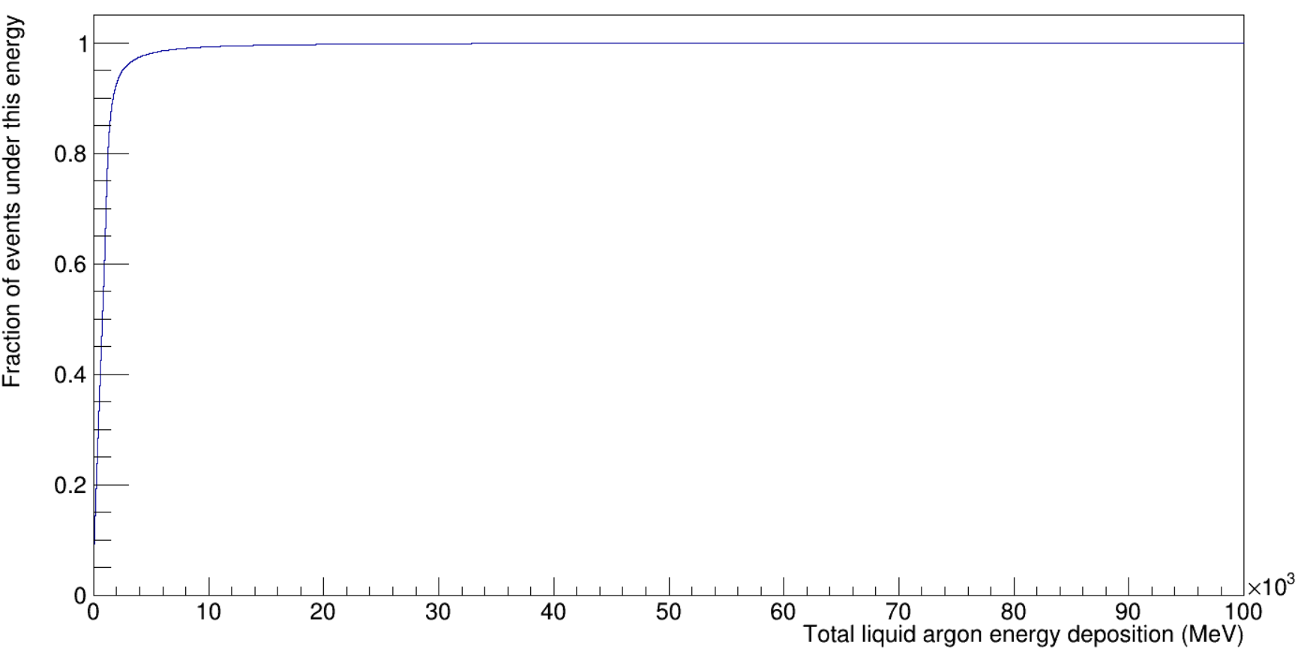
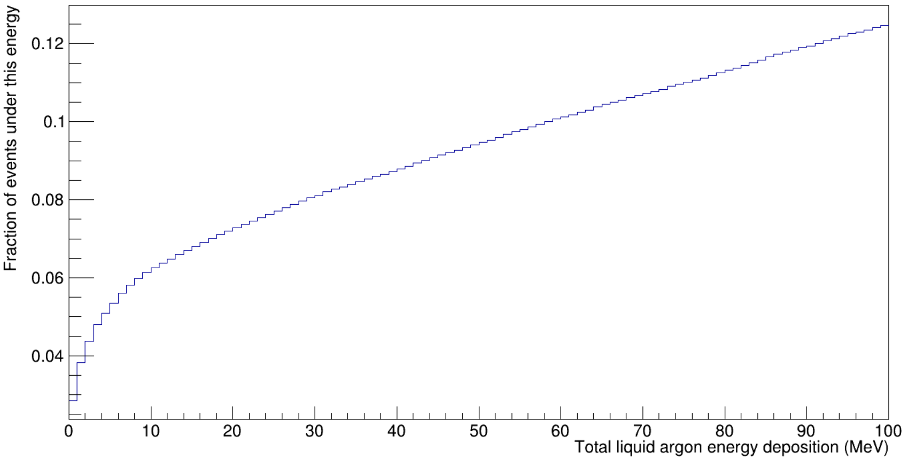
Integral plot – LNGS/R, no cuts
0-100 GeV
0-100 MeV

Slide 4
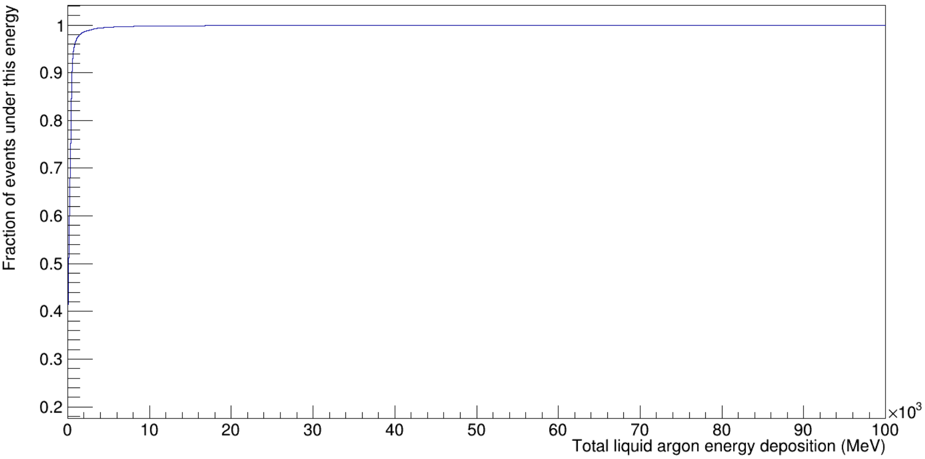
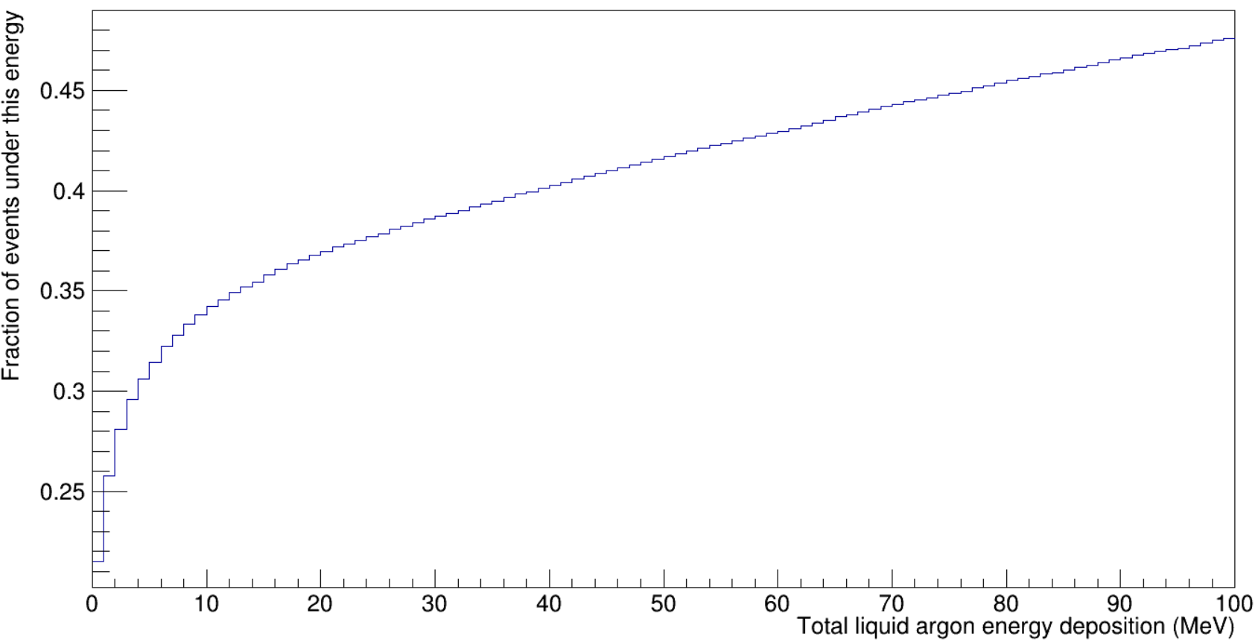
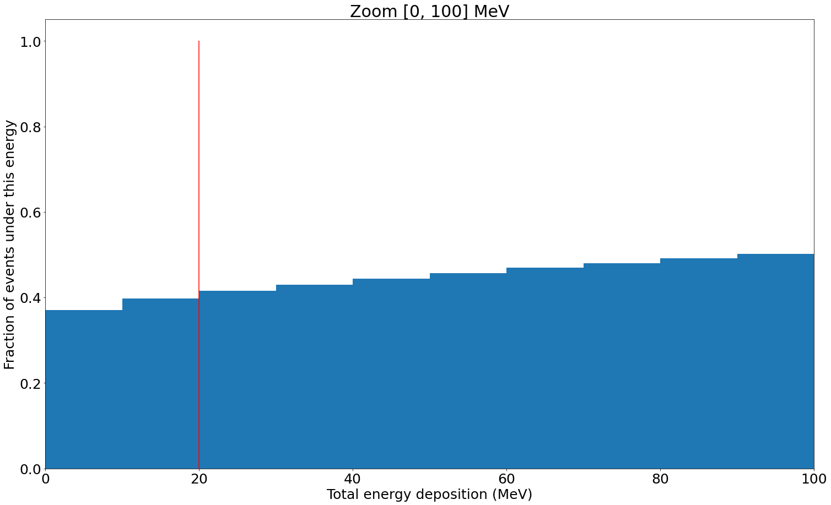
Integral plot – LNGS/R, no cuts, ROI
0-100 GeV
0-100 MeV

Slide 5
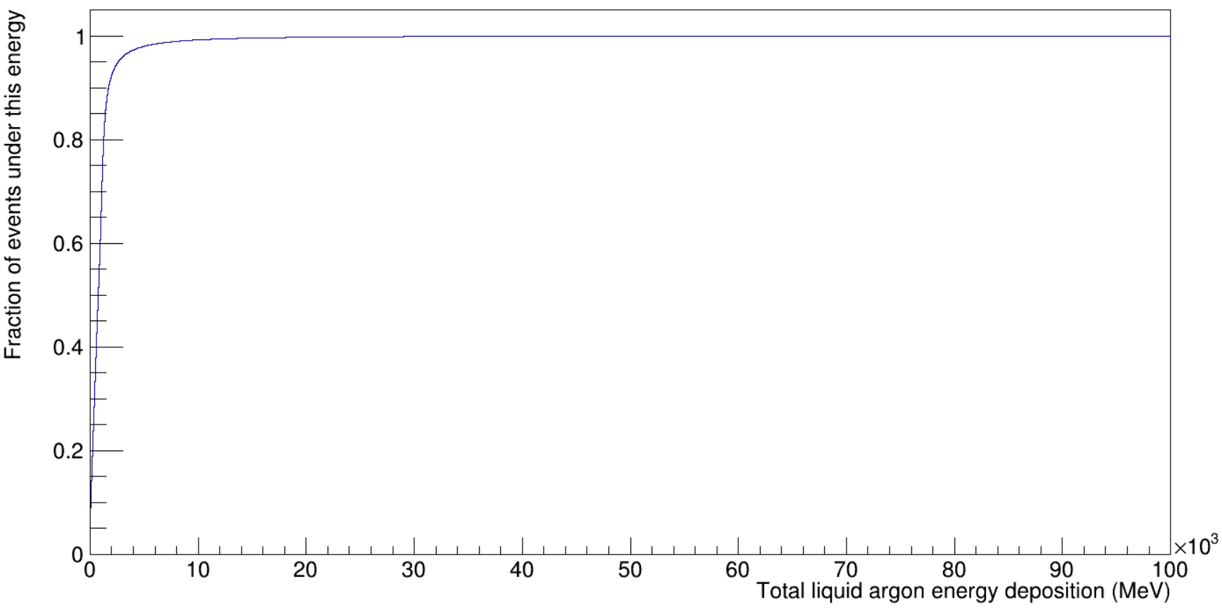
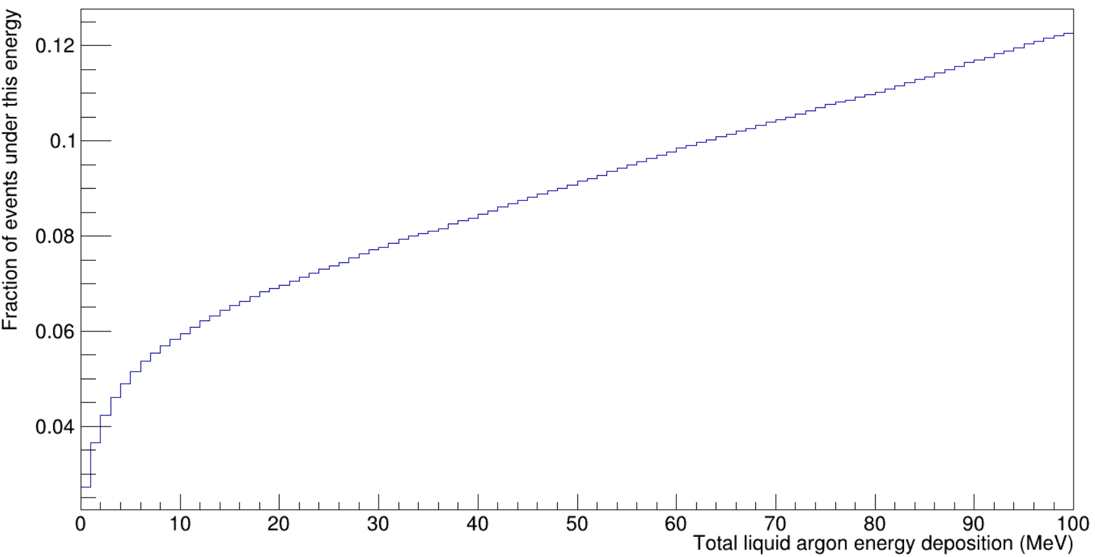
Integral plot – LNGS+, no cuts
0-100 GeV
0-100 MeV

Slide 6
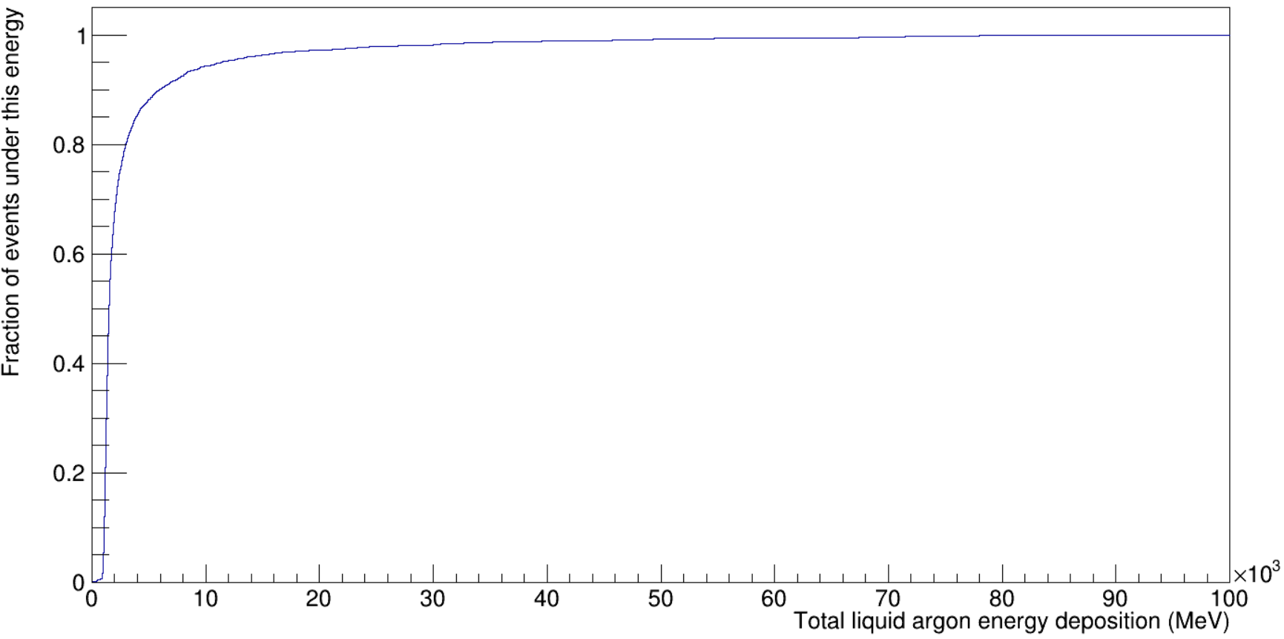
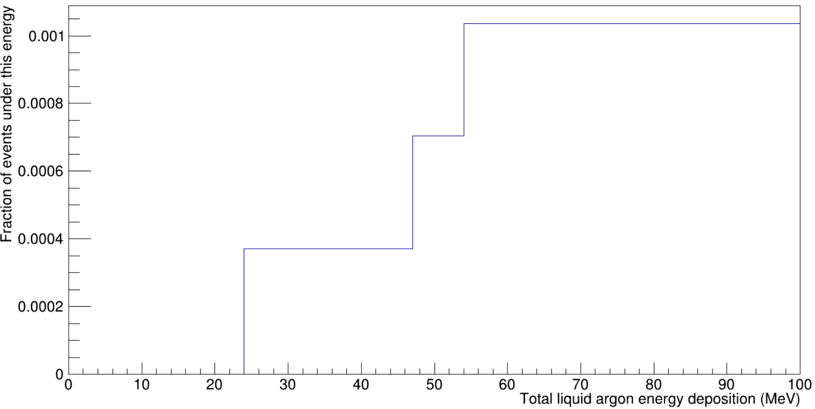
Integral plot – LNGS+, Ge energy>200keV
0-100 GeV
Muon with small deposit in LAr
~2 m
Liquid argon
Ge array
0-100 MeV

Slide 7


Integral plot – LNGS+, ROI
0-100 GeV
0-100 MeV

Slide 8
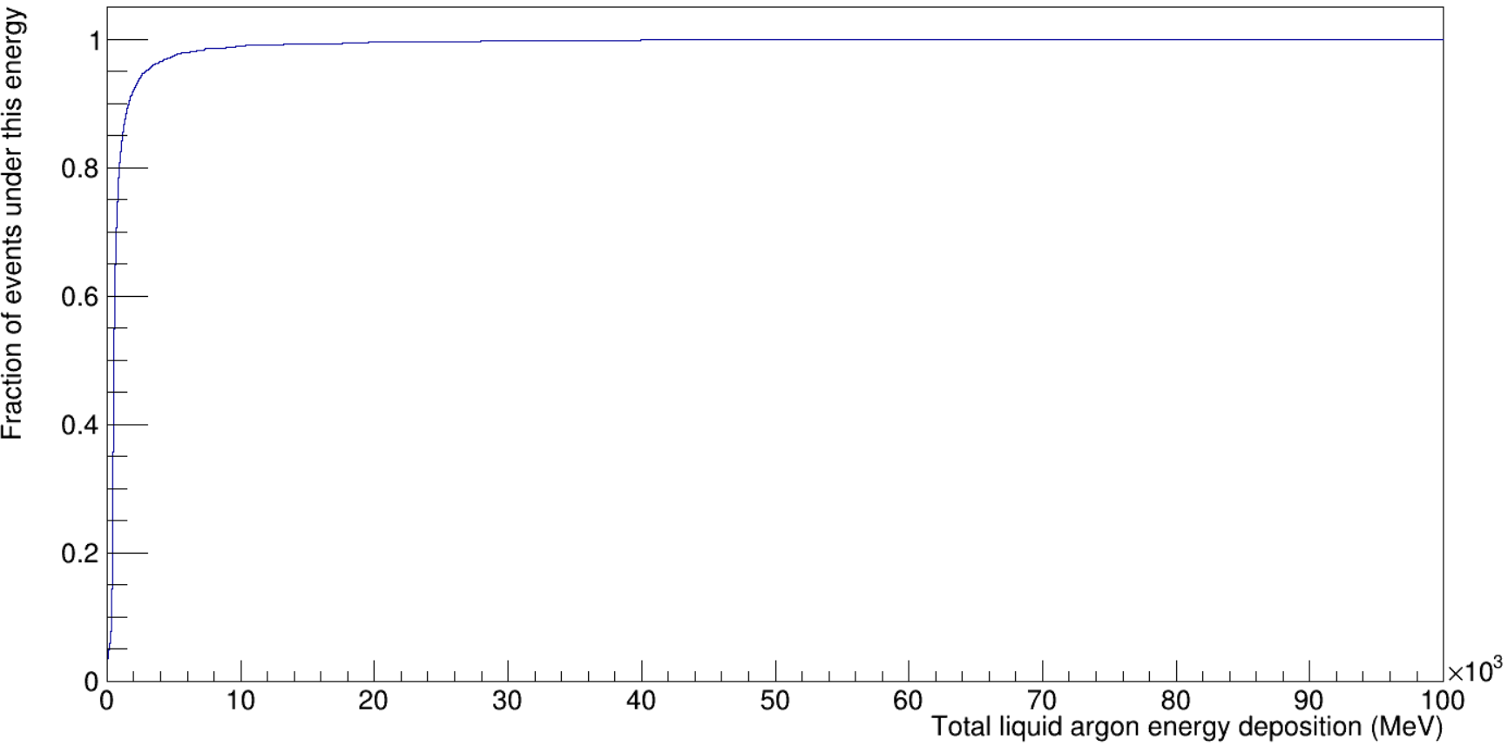
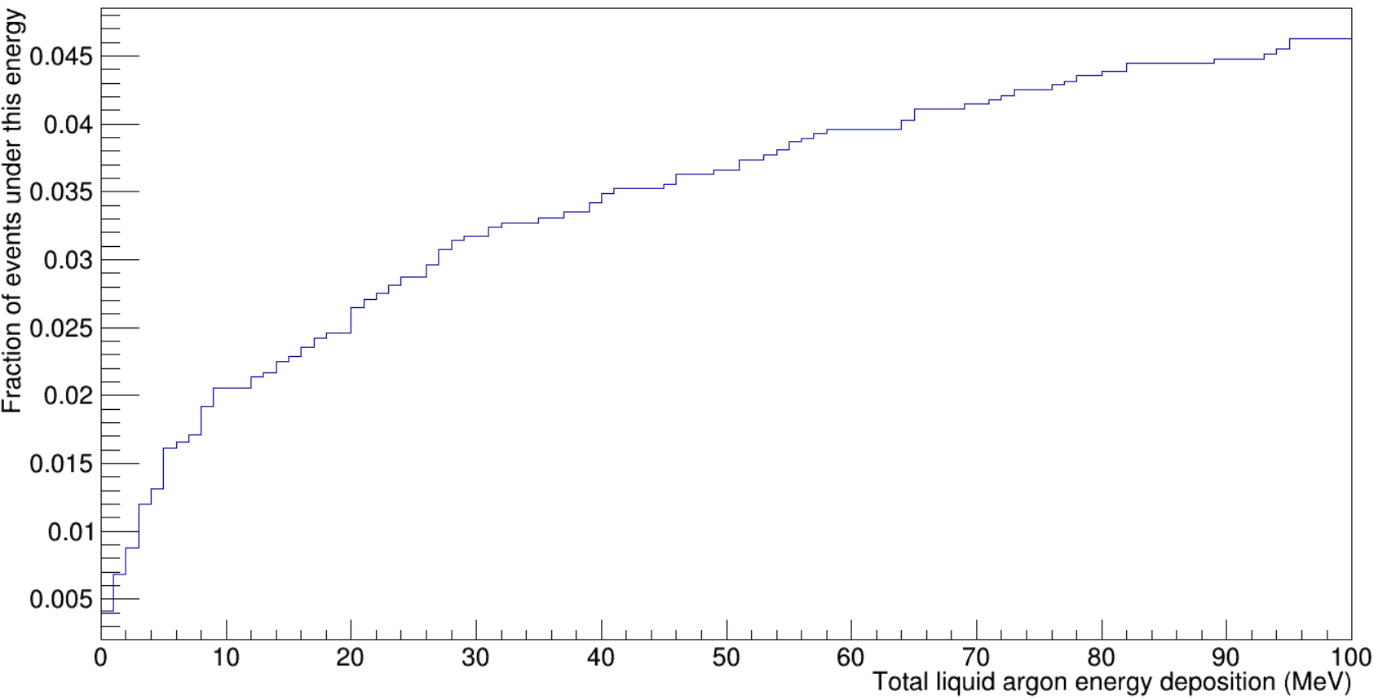
Integral plot – LNGS+, Ge energy>200keV, ROI
Follow-up: Ge energy>50 keV, Ge energy>500keV, etc.
0-100 GeV
Muon with small deposit in LAr
~0.7 m
Liquid argon
Ge array
Smaller ROI volume
0-100 MeV

Slide 9
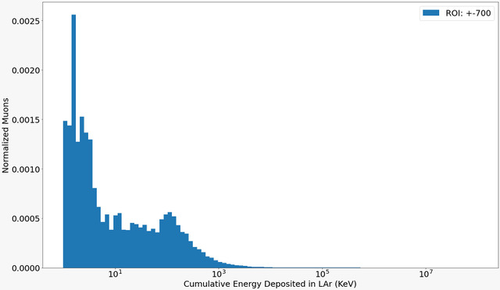
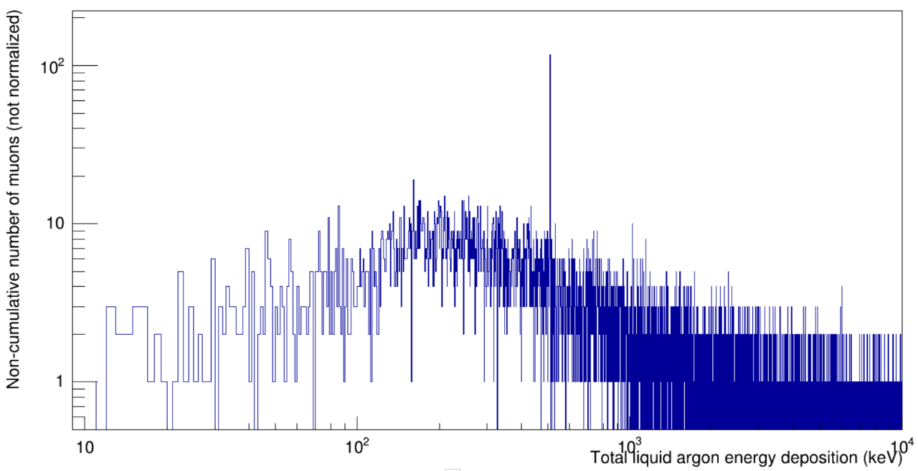
Differential plot comparison

